Slide 1
SOFTWARE DESIGN AND ARCHITECTURE
(PRACTICAL#07)
CREATIONAL DESIGN PATTERNS
(ABSTRACT FACTORY)

Slide 2
ABSTRACT FACTORY PATTERN
The Abstract Factory design pattern (part of the Gang of Four) falls under the Creational design pattern category and it provides a way to encapsulate a group of factories that have a common link without highlighting their concrete classes. This is all about a factory creating various objects at run time based on user demand. The client remains completely unaware (decoupled) on which concrete products it gets from each of these individual factories and the client is only able to access a simplified interface.

Slide 3
Intent: Provide an interface for creating families of related or dependent objects without specifying their concrete classes.
Also Known As: Kit

Slide 4






Abstract Factory Pattern in Real Life
Abstract Factory Pattern is similar to Sub Contracting in real world.
Basically delegating the creation of Objects to expert Factories
-----------------------------------
Orders in a restaurant are received by a Kitchen.
Then are assigned to Special Chefs like
Chinese, Indian, Continental.
Abstract Factory Pattern is a Creational Pattern.

Slide 5
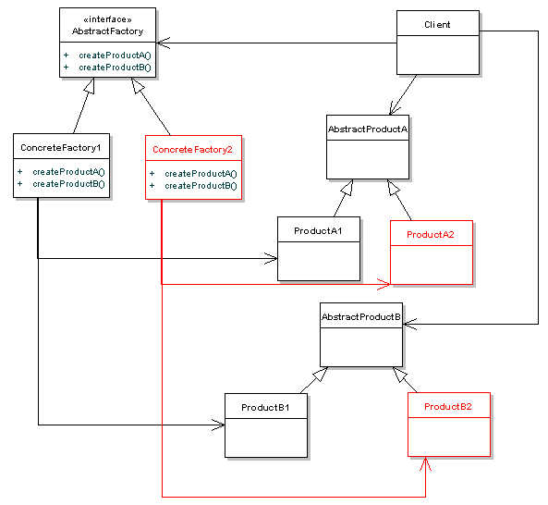
Abstract Factory Pattern in Java: STRUCTURE

Slide 6

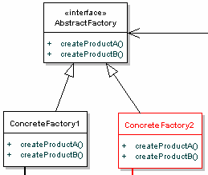
Real Life vs Java Object
Factory
Kitchen

Slide 7

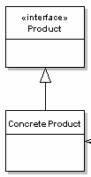

Real Life vs Java Object

Slide 8
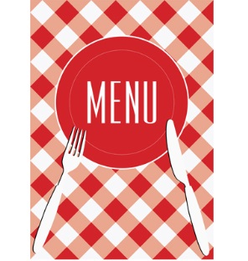
How Factory Pattern works in Real Life ?
1
Orders a Dish from Menu
2
Receives the Order
Creates the Dish
3
Outsources to Chef
4
Delivers the Dish

Slide 9
Motivation
Consider a garments factory specialized in creating trousers and shirts. Now the Parent company which is a famous Retail brand is now venturing into Gadget section. They are also planning to expand their Factories having one centre in US and another one in UK. The client should be completely unaware of how the objects are created. What is the best design pattern we can use to resolve this requirement?

Slide 10
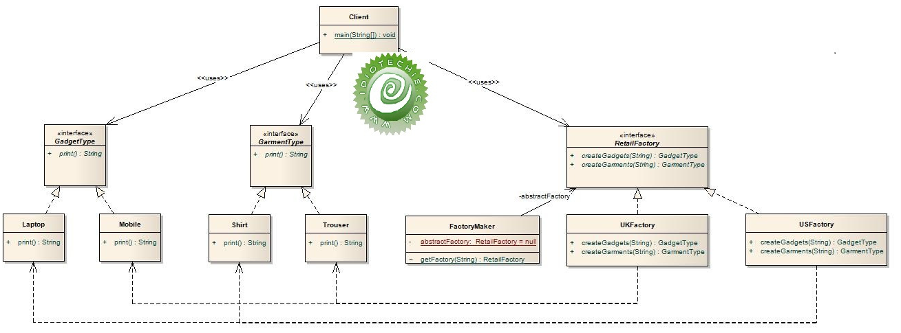

Slide 11
Applicability
Use the Abstract Factory pattern when
● a system should be independent of how its products are created, composed, and represented.
● a system should be configured with one of multiple families of products.
● a family of related product objects is designed to be used together, and you need to enforce this constraint.
● you want to provide a class library of products, and you want to reveal just their interfaces, not their implementations.

Slide 12
Participants
Participants
● AbstractFactory
❍ declares an interface for operations that create abstract product objects.
● ConcreteFactory
❍ implements the operations to create concrete product objects.
● AbstractProduct
❍ declares an interface for a type of product object.
● ConcreteProduct
❍ defines a product object to be created by the corresponding concrete factory.
❍ implements the AbstractProduct interface.
Client
❍ uses only interfaces declared by AbstractFactory and AbstractProduct classes.

Slide 13
Collaboration
Collaborations
● Normally a single instance of a ConcreteFactory class is created at run-time. This concrete factory creates product objects having a particular implementation. To create different product objects, clients should use a different concrete factory.
● AbstractFactory defers creation of product objects to its ConcreteFactory subclass.

Slide 14
Consequences
It isolates concrete classes.
It makes exchanging product families easy. (e.g changing motif to pm)
It promotes consistency among products. When product objects in a family are designed to work together, it's important that an application use objects from only one family at a time. AbstractFactory makes this easy to enforce.
Supporting new kinds of products is difficult.

Slide 15
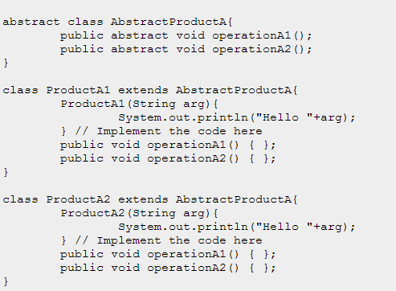
Sample Code (Implementation)

Slide 16
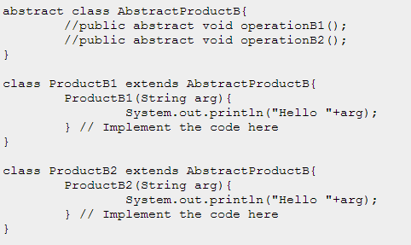

Slide 17
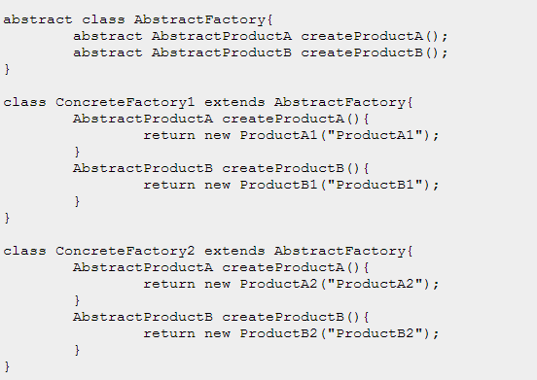

Slide 18
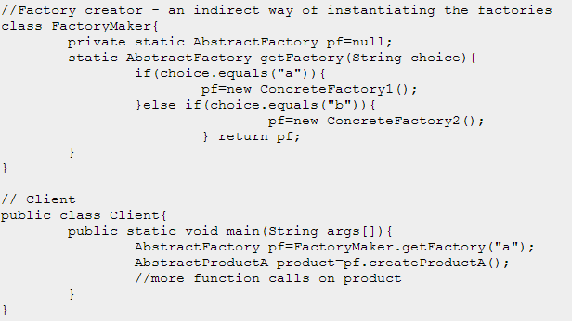

Slide 19
Known uses
To create look and feel in views (toolkits)
Portability across different multiple systems

Slide 20
Related Patterns
Related Patterns
AbstractFactory classes are often implemented with factory methods (Factory Method), but they can also be implemented using Prototype.
A concrete factory is often a singleton (Singleton).

Slide 21
Benefits: Use of this pattern makes it possible to interchange the concrete classes without changing the client code even at runtime. Drawback: One of the main drawbacks is the extra complexity and writing the code during the initial stages.

Slide 22
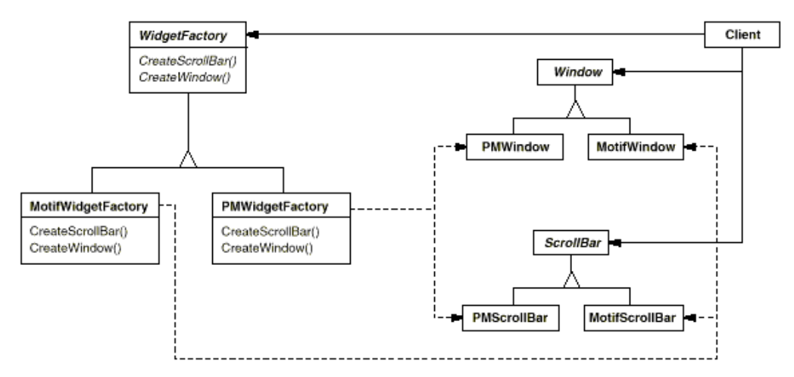
Practical Task: Implement the Abstract Factory Pattern. Class diagram is given below:

